Slide 1

Annual Title I Meeting
September 9, 2025 4:30 pm
September 11, 2025 9:00 am
Dr. LaWanda M. Clark, Principal Mr. Marcus T. Shead, Asst. Principal

Slide 2
Why Are We Here?
The Every Student Succeeds Act (ESSA) requires that each Title I school hold an annual meeting of Title I families in order to:
      inform you of your school’s participation in Title I,
      explain the requirements of Title I, and
      explain your rights as parents and family members to be involved.

Slide 3
Welcome & Meet the Staff
Leadership Team
Office Staff
6th Grade
7th Grade
8th Grade
Special Education
Exploratory
Student Support Staff

Slide 4
What Will I Learn?
What is a Title I school?
What are my rights?
What can Title I funds be used for?
How does our school use Title I funds?
What is the SIP?
What are our schoolwide program goals?
How is parent and family engagement funded?
What is the Parent and Family Engagement Policy?
What is the School-Parent Compact?
What curriculum does our school use?
What tests will my child be taking?
How can I be involved?
Who can I contact for help?

Slide 5
What is a Title I School?
Title I was passed in 1965 under the Elementary and Secondary Education Act (ESEA). It is the largest federal assistance program for our nation’s schools.
Title I schools receive extra funding (Title I dollars) from the federal government. These dollars are used to:
      identify students experiencing academic difficulties and provide assistance to help these students;
      purchase additional staff, programs, materials, and/or supplies; and
      conduct parent and family engagement meetings, trainings, events, and/or activities.

Slide 6
What Are My Rights?
The families and parents of Title I students have a right, by law, to:
      be involved in decisions made at both the school and district level;
      be provided with information on your child’s level of achievement on tests in reading/language arts, writing, mathematics, and science;
      request and receive information on the qualifications of your child’s teacher and paraprofessionals who are working with your child [Dr. Clark at lawanda.clark@fraysercs.org or Ms. Taylor at rachelle.taylor@fraysercs.org; and
      request opportunities for regular meetings to formulate suggestions and to participate, as appropriate, in decisions about the education of your child. The school is required to respond to any such suggestions as soon as practicably possible.

Slide 7
How Are Title I Funds Used?
In general, Title I funds my be used for:
      smaller class sizes,
      additional teachers and paraprofessionals,
      additional training for school staff,
      extra time for instruction (before and/or after school programs),
      parent and family engagement activities, and/or
      a variety of supplemental teaching materials, equipment, and technology.

Slide 8
Westside Middle School Will Use Funds To…
In the 2025-2026 school year our school was allotted approximately $ 165,000.00 in Title I funding.
We developed a Schoolwide Program, which means we plan to spend our funds on the following:
      Supplemental staff:
        Paraprofessional
        Administration
      Programs/Materials/Supplies:
        Instructional Resources
      Teacher Professional Development:
        Bridges Teacher PD
        Mental Fitzness

Slide 9
Westside Middle School is a Title I School
What does it mean to be a Title I School?
A Title I school is a federally funded school that receives additional financial support to help students from low-income families achieve academic success.
Overview of Title I
Title I is part of the Elementary and Secondary Education Act (ESEA) and was established to provide financial assistance to schools with a high percentage of students from low-income families. The program aims to ensure that all children have a fair, equitable, and high-quality education, particularly those who are disadvantaged.

Slide 10
Westside Middle School is a Title I School
Funding and Eligibility
Funding Source: Title I funding is the largest federal assistance program for schools in the United States, providing over $14 billion annually to support educational programs for low-income students.
Eligibility Criteria: A school qualifies as a Title I school if at least 40% of its students are eligible for free or reduced-price lunch. This eligibility is determined through applications submitted by families, which report their income levels.

Slide 11
Westside Middle School is a Title I School
Purpose and Impact
The primary goal of Title I funding is to close the achievement gap between low-income students and their peers. Schools use these funds to implement various educational strategies, such as hiring additional teachers, providing tutoring services, and offering after-school programs. Importantly, Title I funds are intended to supplement existing school resources, not replace them, ensuring that all students benefit from the additional support.
Conclusion
In summary, Title I schools are designed to provide extra resources and support to help economically disadvantaged students succeed academically. This federal program plays a crucial role in promoting educational equity across the United States.

Slide 12
How are Title I Funds Utilized?
How are Title I funds used in schools
Title I funds are used to improve outcomes for low-achieving students through activities and strategies identified in a school’s needs assessment and articulated in the school’s comprehensive schoolwide plan. These funds are primarily used for additional staffing to implement interventions or provide instructional support, but can also pay for during- and beyond-school-day tutoring, additional curricular materials, and professional development. Schools use most of these funds to hire additional staff to provide interventionist positions, smaller class sizes, and co-teaching opportunities. Additionally, Title I funding supports students with supplemental educational services.

Slide 13
What is the School Improvement Plan?
The SIP is the School Improvement Plan. It includes:
      the identification of the school planning team and how they will be engaged in the planning process;
      a needs assessment and summary of academic and non-academic data;
      prioritized goals, strategies, and action steps to help address the academic and non-academic needs of students;
      teacher and staff professional development needs; and
      budgets and the coordination of resources.
The school must include family representatives on our school planning team.

Slide 14
Westside Middle School’s School Improvement Plan
LIVING document that collaborates with a team of stakeholders to:
  Analyze Schools Data
  Identify School Needs
  Create Goals, Strategies and Action Steps
  Current School Improvement Plan is accessible on the fraysercs.org website

Slide 15
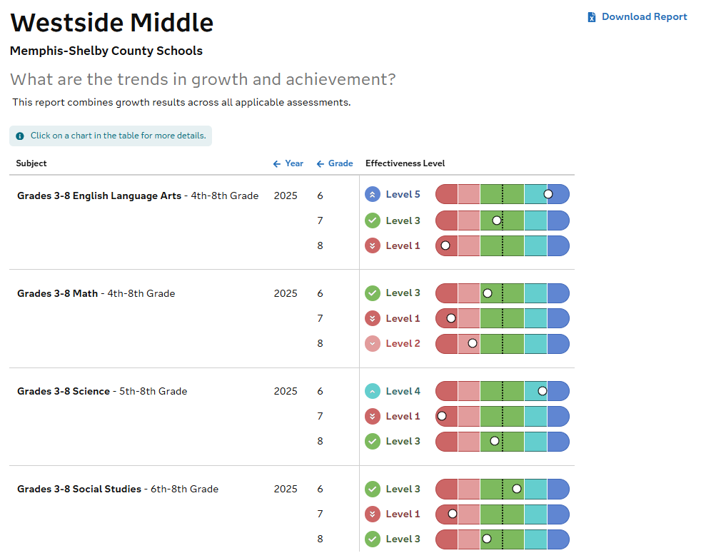
Westside Middle School Data

Slide 16
Westside Middle School SIP Goals
G 1 Improve ELA and Math proficiency and increase the number of 6th to 8th grade students proficient on the TCAP assessment administered in 2025-2026 from 4.3% (2024-2025) to 6% (2025-2026) in ELA and from 3.1% (2024-2025) to 6% (2025-2026) in Math.
G 2 In 2025-2026, Westside Middle School aims to create a safe and healthy environment to reduce chronic absenteeism from 49% in 2024-2025- to 40% in 2025-2026 and increase the attendance rate from 89% in 2024-2025 to 93% in 2025-2026.
G 3 Maintain the recruitment and hiring of highly qualified certified or permit teachers of 100%, while increasing the retention rate from 44% (2024-2025) to 80% by the end of the 2025-2026 school year.

Slide 17
Parent’s Right to Know
Parents have the right to request the following:
A teacher’s professional qualifications, licensure, grade(s) certification, waivers
A teacher’s baccalaureate and/or graduate degree, fields of endorsement, previous teaching experience
A paraprofessional’s qualifications
An assurance that their child’s name, address and telephone listing will not be released to military recruiters

Slide 18
Parent’s Right to Know
Parents will receive information on the following:
Their child’s level of achievement on each of the state’s academic assessments
Their option to request a transfer to another school within the district if their child is the victim of a violent crime at school
Their right to timely notification that their child has been assigned, or has been taught for four or more consecutive weeks by, a teacher who is not highly qualified.

Slide 19
Reporting Pupil Progress
Any district with a Title I allocation exceeding $500,000 is required by law to set aside 1% of it’s Title I allocation for parent and family engagement.
Of that 1%, 10% may be reserved at the district for system-wide initiatives related to parent and family engagement. The remaining 90% must be allocated to all Title I schools in the district.
You, as Title I parents and family members, have the right to be involved in how this money is spent.

Slide 20
Reporting Pupil Progress
Westside Middle School provides:
Interim progress reports
Report cards every nine weeks
Parent-Teacher Conferences
Parent Portal links
Email/Telephone contacts

Slide 21
How Is Parent Family Engagement Funded?
In 2024-2025 school, we received approximately $3,300 in parent and family engagement funding. We plan to use these funds for:
      Parent and Family Engagement Meeting and Events
        PAC-monthly
        PBIS Training
        Curriculum Night Events
      Materials/Supplies
        Monthly Newsletters

Slide 22
Family Engagement Plan Goals
Westside Middle School has the responsibility to provide our parents, teachers, students, and community members with access to shared opportunities to engage in activities that will promote student achievement.
To provide meaningful two-way communication
To provide meaningful and varied participation opportunities for families that support student achievement
To eliminate or reduce barriers to family involvement
To provide parents with an opportunity to participate in the development of our School Improvement Plan

Slide 23
What Is The Parent Engagement Policy?
These plans address how the district and school will implement the parent and family engagement requirements of ESSA. Components should include:
      how parents and families can be involved in decision-making and activities;
      how parent and family engagement funds are being used;
      how information and training will be provided to families; and
      how the school will build capacity in families and staff for strong parent and family engagement.
You, as a Title I parent or family member, have the right to be involved in the development of these plans.
The Parent Engagement Policy can be found at fraysercs.org-Westside Middle School website.
Copies of the policy were distributed at the meeting.

Slide 24
Parental Involvement
Parent Advisory Council
Advocates for parents and their interests in the schools.
Provide feedback and insight from the parent perspective on school processes, policies and initiatives to ensure the needs of families are included as decisions are being made in the network.
Serve as advisors to network leadership, make recommendations and facilitate strategies to help improve the educational outcome for all FCS students.
Serve as ambassador for FCS on education matters.

Slide 25
Parental Involvement
The Parent Advisory Council will meet every 4th Wednesday at 5:00 pm.
Next Meeting:
WEDNESDAY, September 24,2025
WESTSIDE MIDDLE SCHOOL 3389 Dawn Drive Memphis, TN 38127 5PM
Meeting Dates: (First Semester)
September 24, 2025
October 22, 2025
November 19, 2025

Slide 26
Parental Development Opportunities
Westside Middle School will host a variety of workshops that will equip parents with access to resources and materials. Interim progress reports
Curriculum Nights
Parent Advisory Council
Parent Resource Center
Parent Partnerships with Communities in Schools

Slide 27
Parent-Teacher Conferences
Parent-Teacher Conferences will be held twice annually.
The dates for this year are:
Sept. 9th
Feb. 10th
Note: Parents, teachers and school leadership may request conferences with individuals at any time during the school year.

Slide 28
School/Parent Compact
Teacher Agreement:
It is important that students achieve, so I will:
Provide high quality instructions to students, daily
Provide parents with access to resources and materials that can be used to aid children at home
Input grades into PowerSchool
School’s Responsibility:
Provide a safe environment that allows for positive communication between teachers, parents, and students
Provide necessary parent conferences and review School/Parent Compact plans
Provide access to a high quality curriculum and instruction for a supportive and effective learning environment
Allow parents and community members to volunteer, participate and observe student learning environments-submit request to Ms. Rachelle Taylor, Dean of C & I

Slide 29
What Is the School Parent Compact
A school-parent compact is a written commitment that outlines how the entire school community – teachers, families, and students will share the responsibility for improved academic achievement.
The compact must describe how the school will:
      provide high-quality curriculum and instruction;
      hold parent-teacher conferences, annually in elementary schools;
      provide parents with reports on their child’s progress;
      provide parents reasonable access to staff.
      provide parents opportunities to volunteer; and
      ensure regular two-way meaningful communication between family members and staff, to the extent practicable, in a language family members can understand.
You, as a Title I parent or family member, have the right to be involved in the development of the compact.
You will receive a copy of the compact during the meeting.
The compact can also be found on the Westside Middle School website. Fraysercs.org

Slide 30
Student’s Responsibility
Student Agreement:
It is important that students:
Attend school every day unless ill
Attend class prepared with books, pencils, paper, and other materials
Complete and return all clasas and homework assignments and keep regular study hours
Conform to school rules and rules of the Student Code of Conduct

Slide 31
Parent’s Responsibility
Parent /Guardian Agreement:
Parent’s will take responsibility for helping their child achieve,
They will:
Support the school with its efforts to maintain a high rate of attendane
Support the school with its effort to provide a safe and healthy environment
Communicate regularly with their chidl’s teacher and leadership team
Motivate their child to be excellent representations of their families, communities and themselves, at all times

Slide 32
Student Code of Conduct
Speaks to the shared responsibility of student’s conduct
  District/school
  Parent
  Student
Speaks to self-discipline being the long-term goal for all students
Gives notice of infractions as well as strategies and/or disciplinary measures for levels of offenses

Slide 33
Tutoring Program
Tutoring dates are TBD from 3:30-5:00
Parents will be notified if your child has been selected for the program
Spaces are on a first come, first serve basis
ALL Westside Middle School students will receive additional instruction in ELA/Math (Reading Intervention/Math Lab during the school day)
Snacks will be provided for all tutoring students

Slide 34
Curriculum
The Tennessee Academic Standards provide a common set of expectations for what students will know and be able to do at the end of a grade for each subject area.
Tennessee's academic standards form the framework for everything taught at Westside Middle School
For more information about Tennessee’s academic standards, see:
      https://www.tn.gov/content/tn/education/instruction/academic-standards.html
ELA: MyPerspective
Math: Ready Math
Science: McGraw Hill iScience
Social Studies: Gallopade
Intervention: iReady

Slide 35
Academic Assessments
Academic assessment used to measure student progress
  Universal Screener (iReady)
  MVPS (Mastery View Predictive Assessment)
  Curriculum Assessments
  TCAP
Proficiency levels students are expected to meet
On Grade Level or Above

Slide 36
How Can You Get Involved?
We need you! Research has proven that family engagement in education has more impact on student achievement than any other factor.
To get involved with the SIP: Dr. Clark at lawanda.clark@fraysercs.org
To get involved with the Parent and Family Engagement Policy: Mr. Shead @ mshead@fraysercs.org
To get involved with the School Parent Compact, [insert information on how families can be involved: Mr. Shead mshead@fraysercs.org

Slide 37
Questions & Comments
If you have any questions or comments please reach out for
support.
Student and Family Support
Mrs. Shevonne Harrell,
Professional School Counselor
Shevonne.Harrell@fraysercs.org
Ms. Ebony Campbell
Communities in Schools
ecampbell@cismemphis.org

Slide 38
Questions & Comments
If you have any questions or comments please reach out for
support.
School Leadership
Academics: Ms. Rachelle Taylor,
Dean of Curriculum and Instruction
Rachelle.taylor@fraysercs.org
Behavior: Mrs. Precious Russell,
Dean of Students
Precious.Russell@fraysercs.org

Slide 39
Questions & Comments
If you have any questions or comments please reach out for
support.
School Leadership
Mr. Marcus T. Shead, Assistant Principal
Mshead@fraysercs.org
Dr. LaWanda M. Clark, Principal
lawanda.clark@fraysercs.org

